Slide 1
Module: 4 Probability Distributions
Binomial Distribution – Poisson Distribution – Normal Distribution – Gamma Distribution – Exponential Distribution – Weibull Distribution

Slide 2
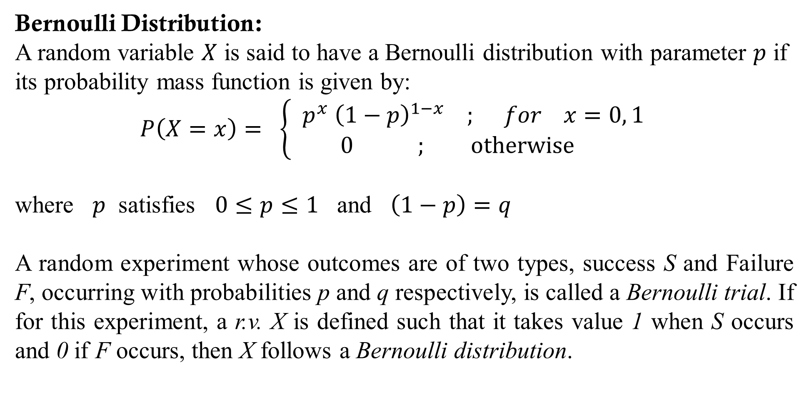
Bernoulli Distribution:
A random variable $X$ is said to have a Bernoulli distribution with parameter $p$ if its probability mass function is given by:
$P\left(X=x\right)= \left\{ \begin{aligned}p^{x} {\left(1−p\right)}^{1−x} ; for x=0, 1 \\ 0 ; otherwise \end{aligned}\right.$
where $p$ satisfies $0≤p≤1$ and $\left(1−p\right)=q$
A random experiment whose outcomes are of two types, success S and Failure F, occurring with probabilities p and q respectively, is called a Bernoulli trial. If for this experiment, a r.v. X is defined such that it takes value 1 when S occurs and 0 if F occurs, then X follows a Bernoulli distribution.

Slide 3

Moments:
$μ_{r}^{′}=E\left(X^{r}\right)=0^{r}∙q+1^{r}∙p$ = $p$
$μ_{1}^{′}=E\left(X^{1}\right)=p$ $μ_{2}^{′}=E\left(X^{2}\right)=p$
$μ_{2}= Var\left(X\right)=$ $p− p^{2}=pq$
Moment generating function:
$M_{X}\left(t\right)=E\left(e^{tX}\right) =$ $e^{t×0} P(X=0)$ $+$ $e^{t×1} P(X=1)$
$M_{X}\left(t\right)=$ $q+pe^{t}$

Slide 4
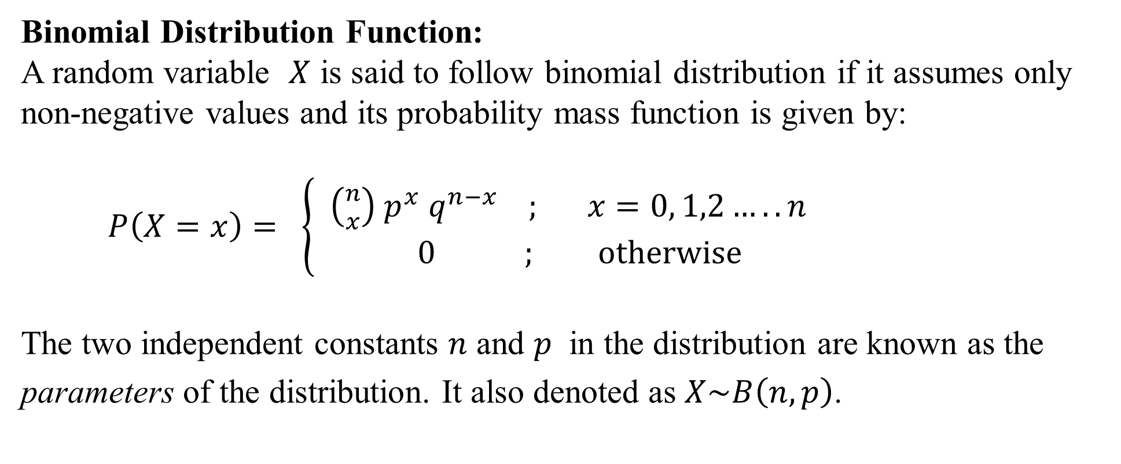
Binomial Distribution Function:
A random variable $X$ is said to follow binomial distribution if it assumes only non-negative values and its probability mass function is given by:
$P\left(X=x\right)= \left\{ \begin{aligned}{\left({n \atop x}\right) p}^{x} q^{n−x} ; x=0, 1,2…..n \\ 0 ; otherwise \end{aligned}\right.$
The two independent constants $n$ and $p$ in the distribution are known as the parameters of the distribution. It also denoted as $X\sim B\left(n,p\right)$.

Slide 5
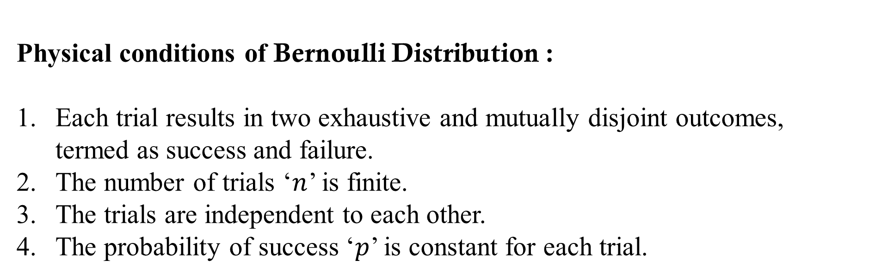
Physical conditions of Bernoulli Distribution :
Each trial results in two exhaustive and mutually disjoint outcomes, termed as success and failure.
The number of trials ‘$n$’ is finite.
The trials are independent to each other.
The probability of success ‘$p$’ is constant for each trial.

Slide 6
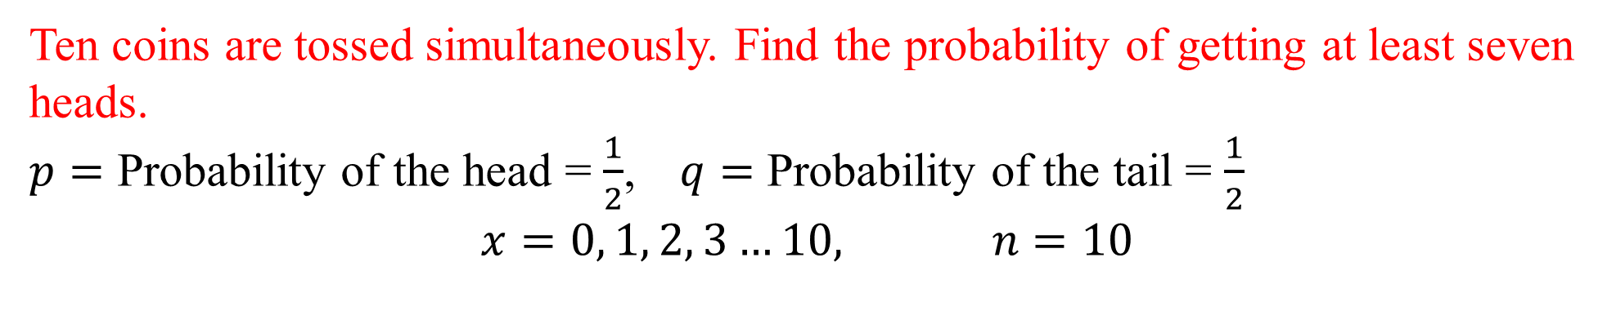
Ten coins are tossed simultaneously. Find the probability of getting at least seven heads.
$p=$ Probability of the head = $\frac{1}{2}$, $q=$ Probability of the tail = $\frac{1}{2}$
$$x=0, 1, 2, 3…10, n=10$$

Slide 7
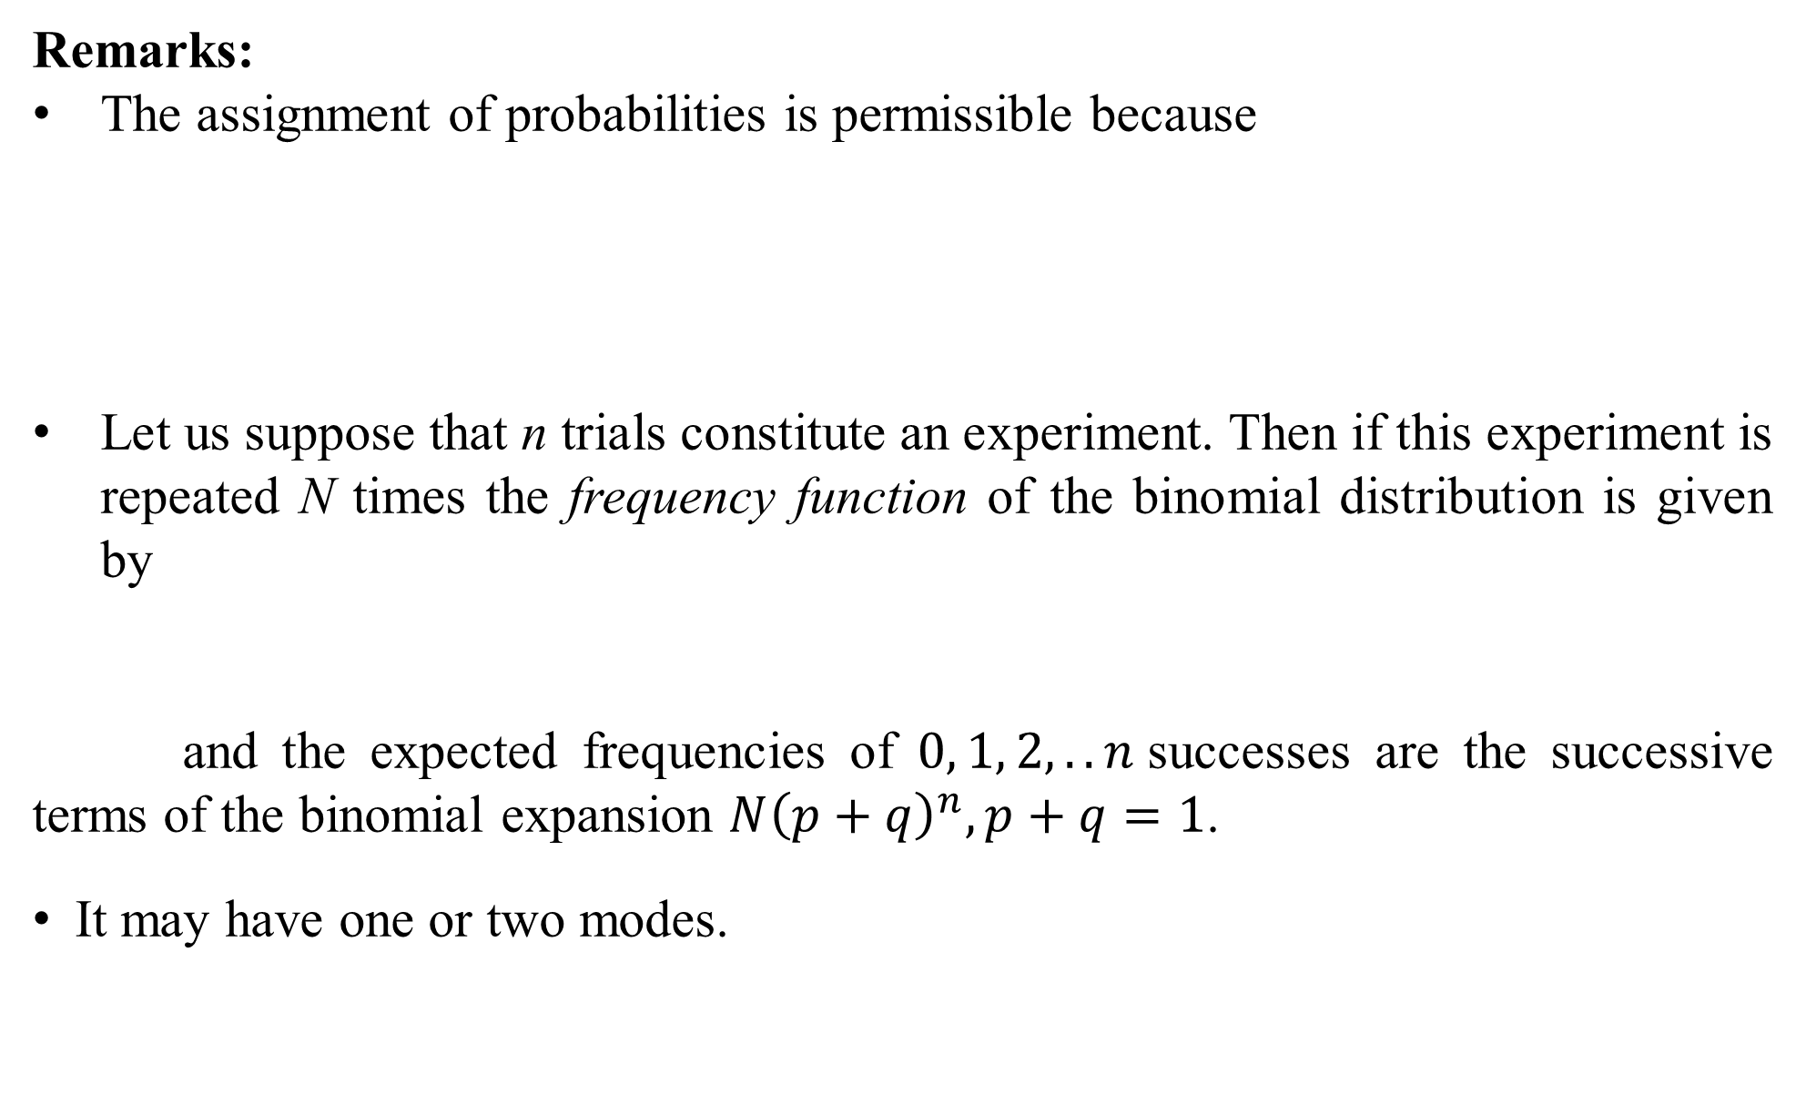
Remarks:
The assignment of probabilities is permissible because
Let us suppose that n trials constitute an experiment. Then if this experiment is repeated N times the frequency function of the binomial distribution is given by
and the expected frequencies of $0, 1, 2, ..n$successes are the successive terms of the binomial expansion $N{\left(p+q\right)}^{n}, p+q=1$.
It may have one or two modes.

Slide 8
An irregular six-faced die is thrown and the expectation that in 10 throws it will give five even numbers is twice the expectation that it will give four even numbers. How many items in 10,000 sets of 10 throws each, would you expect it to give no even number.

Slide 9
Moments of Binomial distribution about origin :

Slide 10
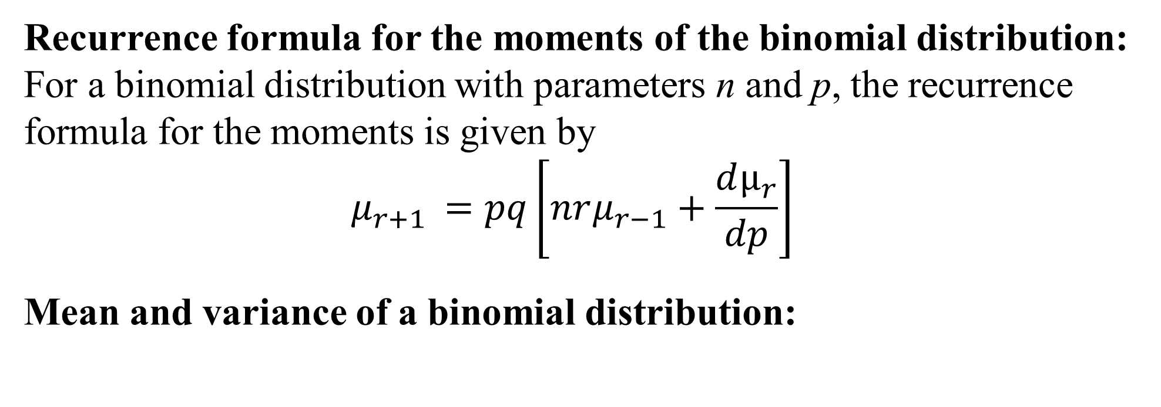
Recurrence formula for the moments of the binomial distribution:
For a binomial distribution with parameters n and p, the recurrence formula for the moments is given by
$$μ_{r+1 }=pq\left[nrμ_{r−1}+\frac{dμ_{r}}{dp}\right]$$
Mean and variance of a binomial distribution:

Slide 11
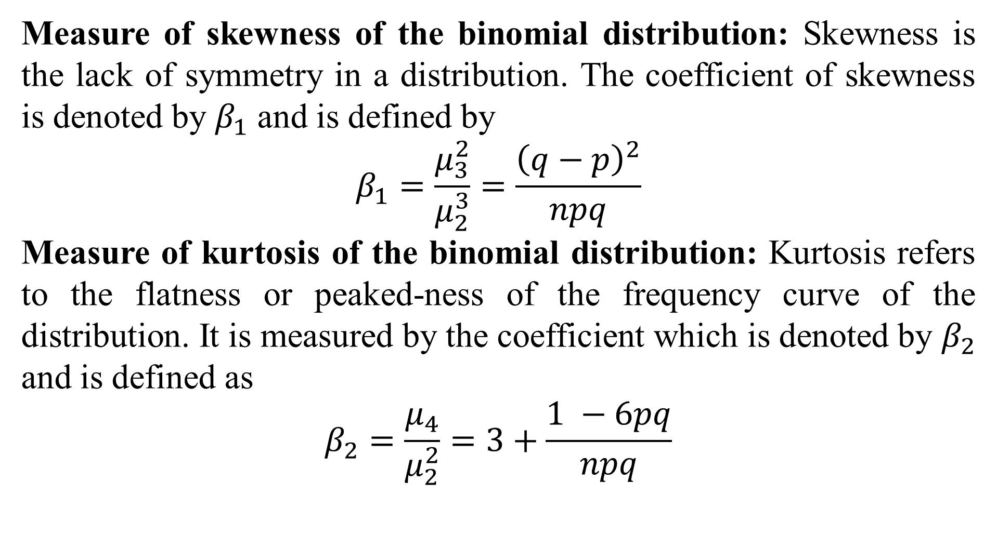
Measure of skewness of the binomial distribution: Skewness is the lack of symmetry in a distribution. The coefficient of skewness is denoted by $β_{1}$ and is defined by
$$β_{1}=\frac{μ_{3}^{2}}{μ_{2}^{3}}=\frac{{\left(q−p\right)}^{2}}{npq}$$
Measure of kurtosis of the binomial distribution: Kurtosis refers to the flatness or peaked-ness of the frequency curve of the distribution. It is measured by the coefficient which is denoted by $β_{2}$ and is defined as
$$β_{2}=\frac{μ_{4}}{μ_{2}^{2}}=3+\frac{1 −6pq}{npq}$$

Slide 12
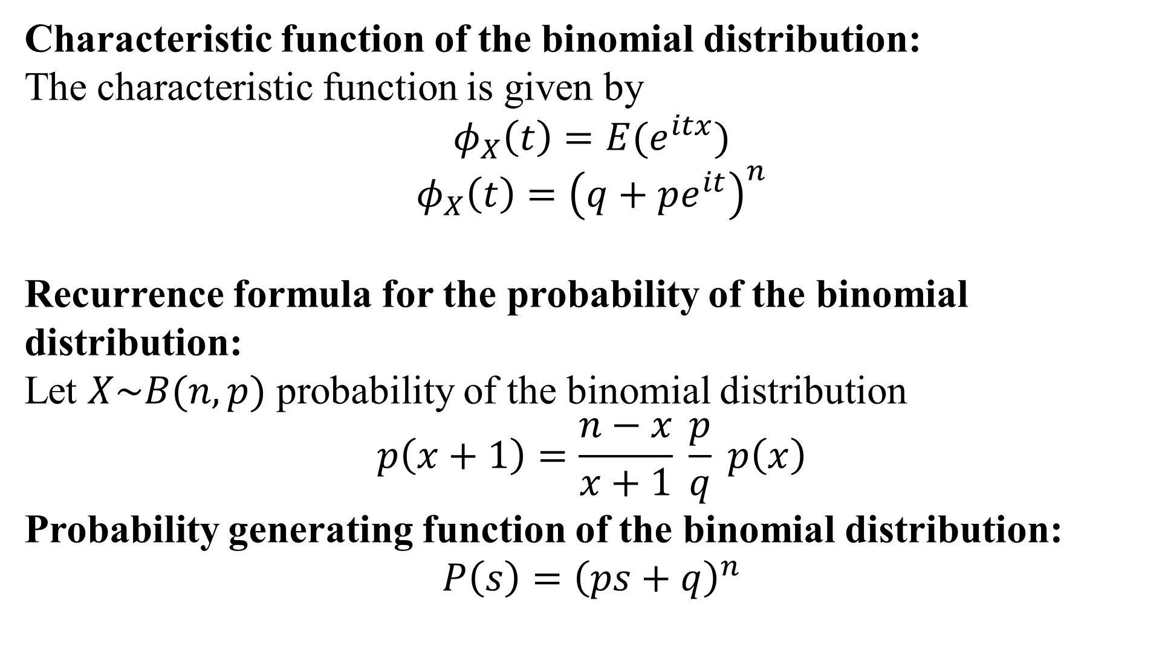
Characteristic function of the binomial distribution:
The characteristic function is given by
$$φ_{X}\left(t\right)=E(e^{itx})$$
$$φ_{X}\left(t\right)={\left(q+pe^{it}\right)}^{n}$$
Recurrence formula for the probability of the binomial distribution:
Let $X\sim B(n, p)$ probability of the binomial distribution
$$p\left(x+1\right)=\frac{n−x}{x+1} \frac{p}{q} p\left(x\right)$$
Probability generating function of the binomial distribution:
$$P\left(s\right)={\left(ps+q\right)}^{n}$$

Slide 13
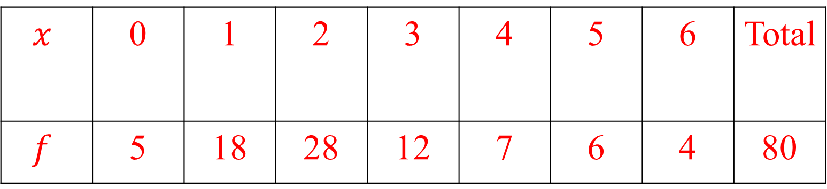
Fit the binomial distribution for the following g data
$$x$$ | 0 | 1 | 2 | 3 | 4 | 5 | 6 | Total
$$f$$ | 5 | 18 | 28 | 12 | 7 | 6 | 4 | 80

Slide 14
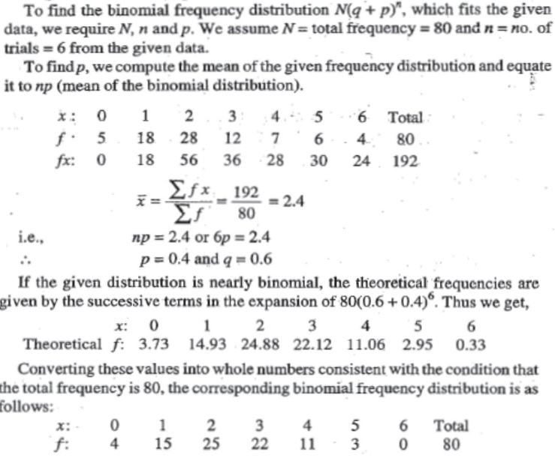

Slide 15
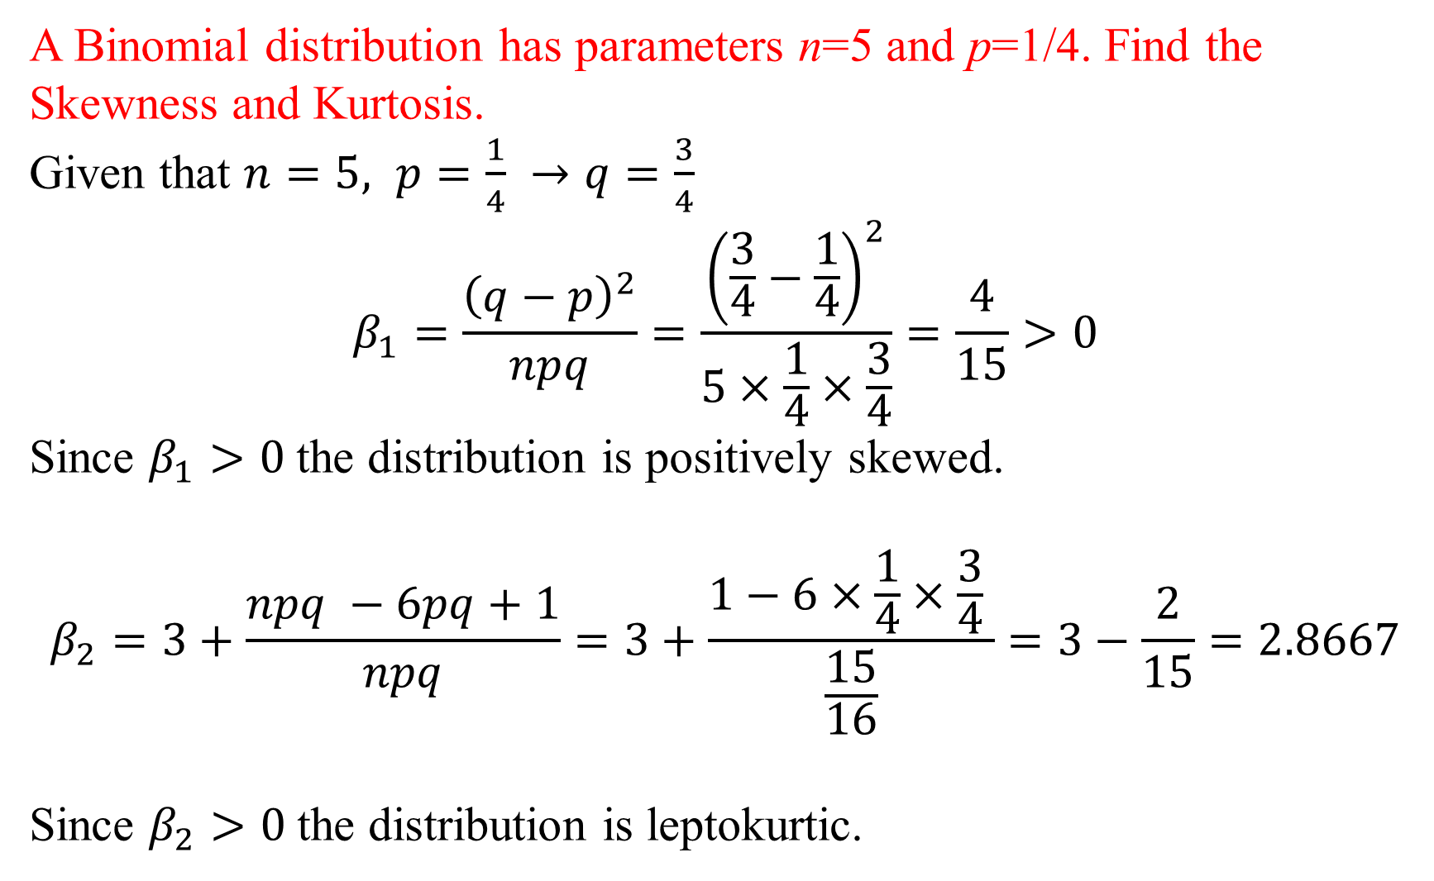
A Binomial distribution has parameters n=5 and p=1/4. Find the Skewness and Kurtosis.
Given that $n=5, p=\frac{1}{4} →q=\frac{3}{4}$
$$β_{1}=\frac{{\left(q−p\right)}^{2}}{npq}=\frac{{\left(\frac{3}{4}−\frac{1}{4}\right)}^{2}}{5×\frac{1}{4}×\frac{3}{4}}=\frac{4}{15}>0$$
Since $β_{1}>0$the distribution is positively skewed.
$$β_{2}=3+\frac{npq −6pq+1}{npq}=3+\frac{1−6×\frac{1}{4}×\frac{3}{4} }{\frac{15}{16}}=3−\frac{2}{15}=2.8667$$
Since $β_{2}>0$the distribution is leptokurtic.

Slide 16
Practice problems:
Out of 800 families with 4 children each, how many families would be expected to have i) 2 boys and 2 girls, ii) at least 1 boy iii) at most 2 girls, and iv) children of both sexes, Assume equal probabilities for boys and girls.
An irregular 6 faced die is such that the probability that it gives 3 even numbers in 5 throws is twice the probability that it gives 2 even numbers in 5 throws. How many sets of exactly 5 trails can be expected to give no even number out of 2500 sets?

Slide 17
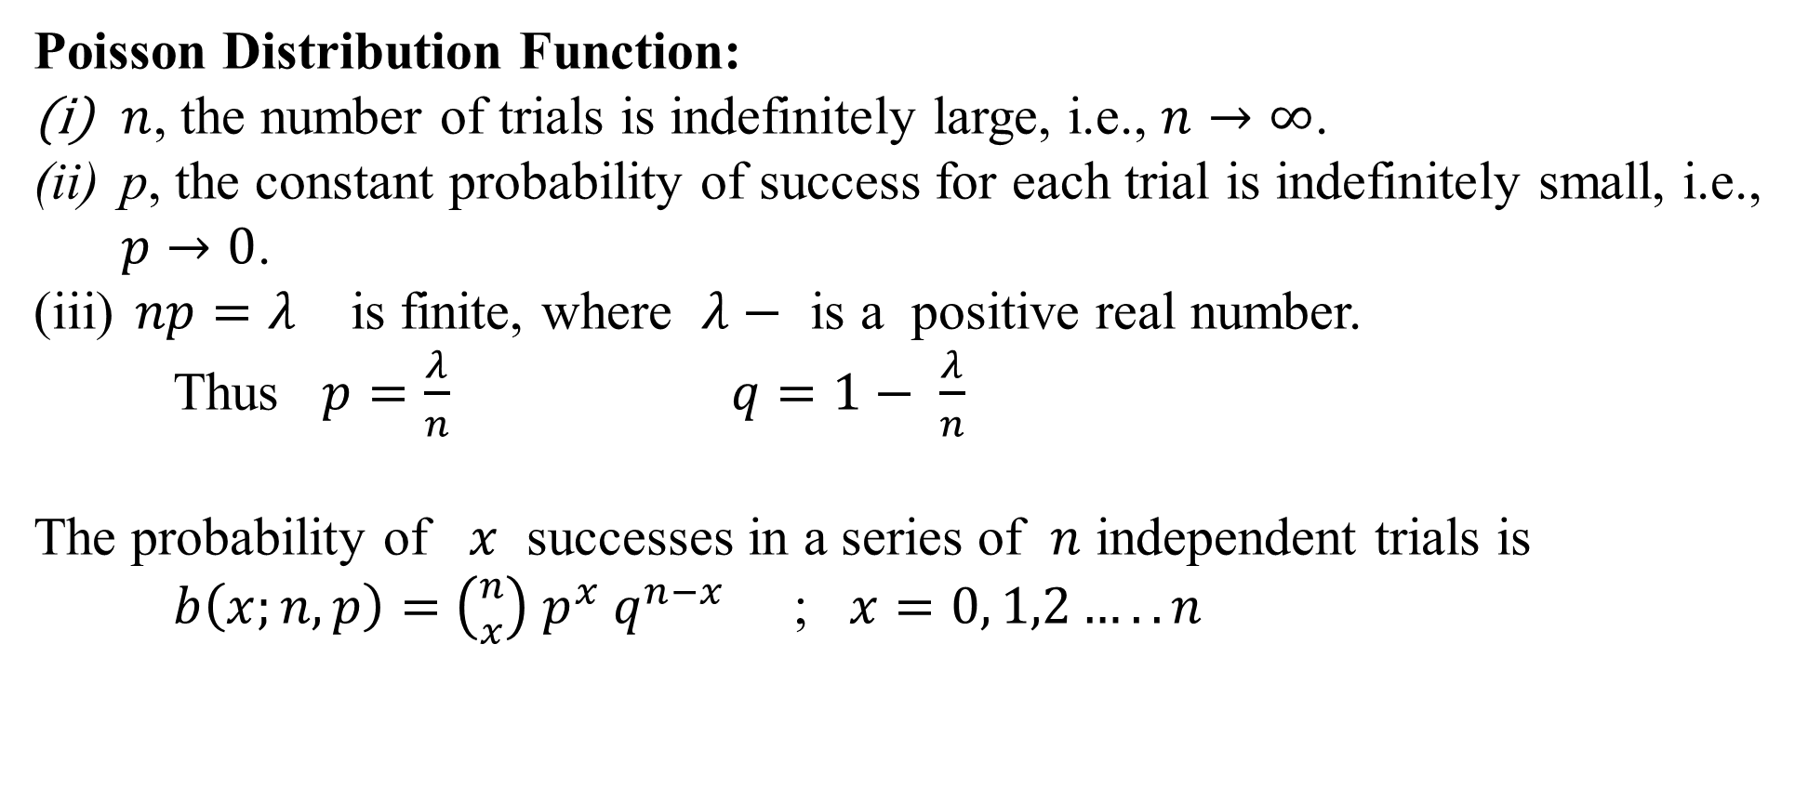
Poisson Distribution Function:
$n$, the number of trials is indefinitely large, i.e., $n→∞$.
p, the constant probability of success for each trial is indefinitely small, i.e., $p→0$.
$np=λ$ is finite, where $λ−$ is a positive real number.
Thus $p=\frac{λ}{n}$ $q=1− \frac{λ}{n}$
The probability of $x$ successes in a series of $n$ independent trials is
$b\left(x;n, p\right)=$ ${\left({n \atop x}\right) p}^{x} q^{n−x}$ ; $x=0, 1,2…..n$

Slide 18
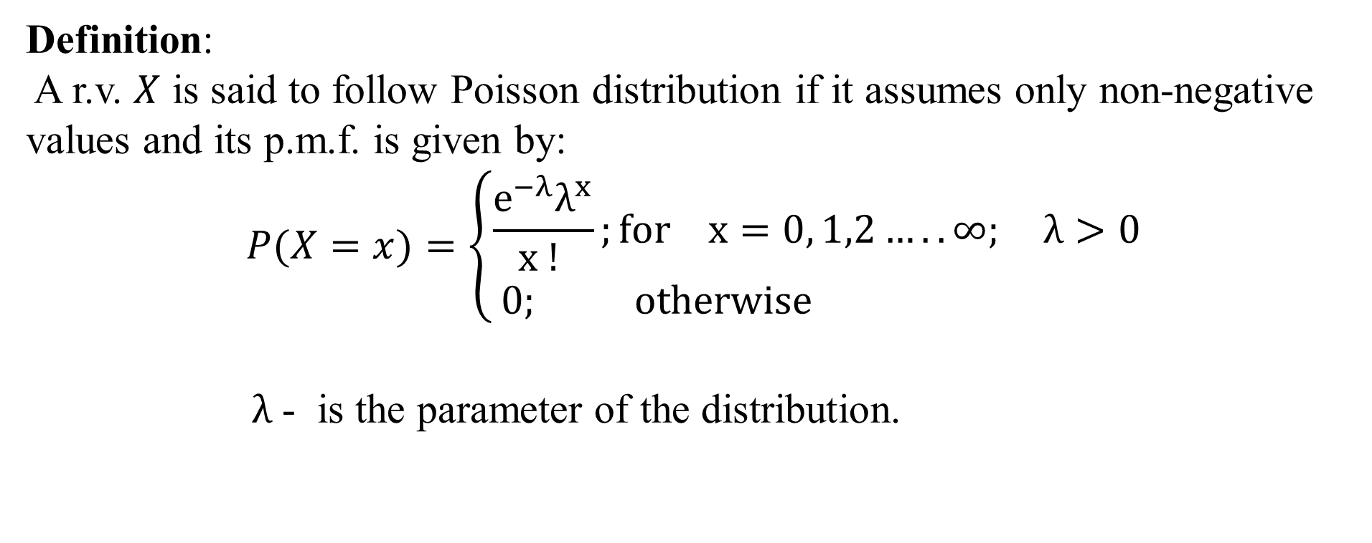
Definition:
A r.v. $X$ is said to follow Poisson distribution if it assumes only non-negative values and its p.m.f. is given by:
$$P(X=x)=\left\{\begin{aligned}\frac{e^{−λ}λ^{x}}{x ! };for x=0, 1,2…..∞; λ>0 \\ 0; otherwise \end{aligned}\right.$$
$λ$ - is the parameter of the distribution.

Slide 19
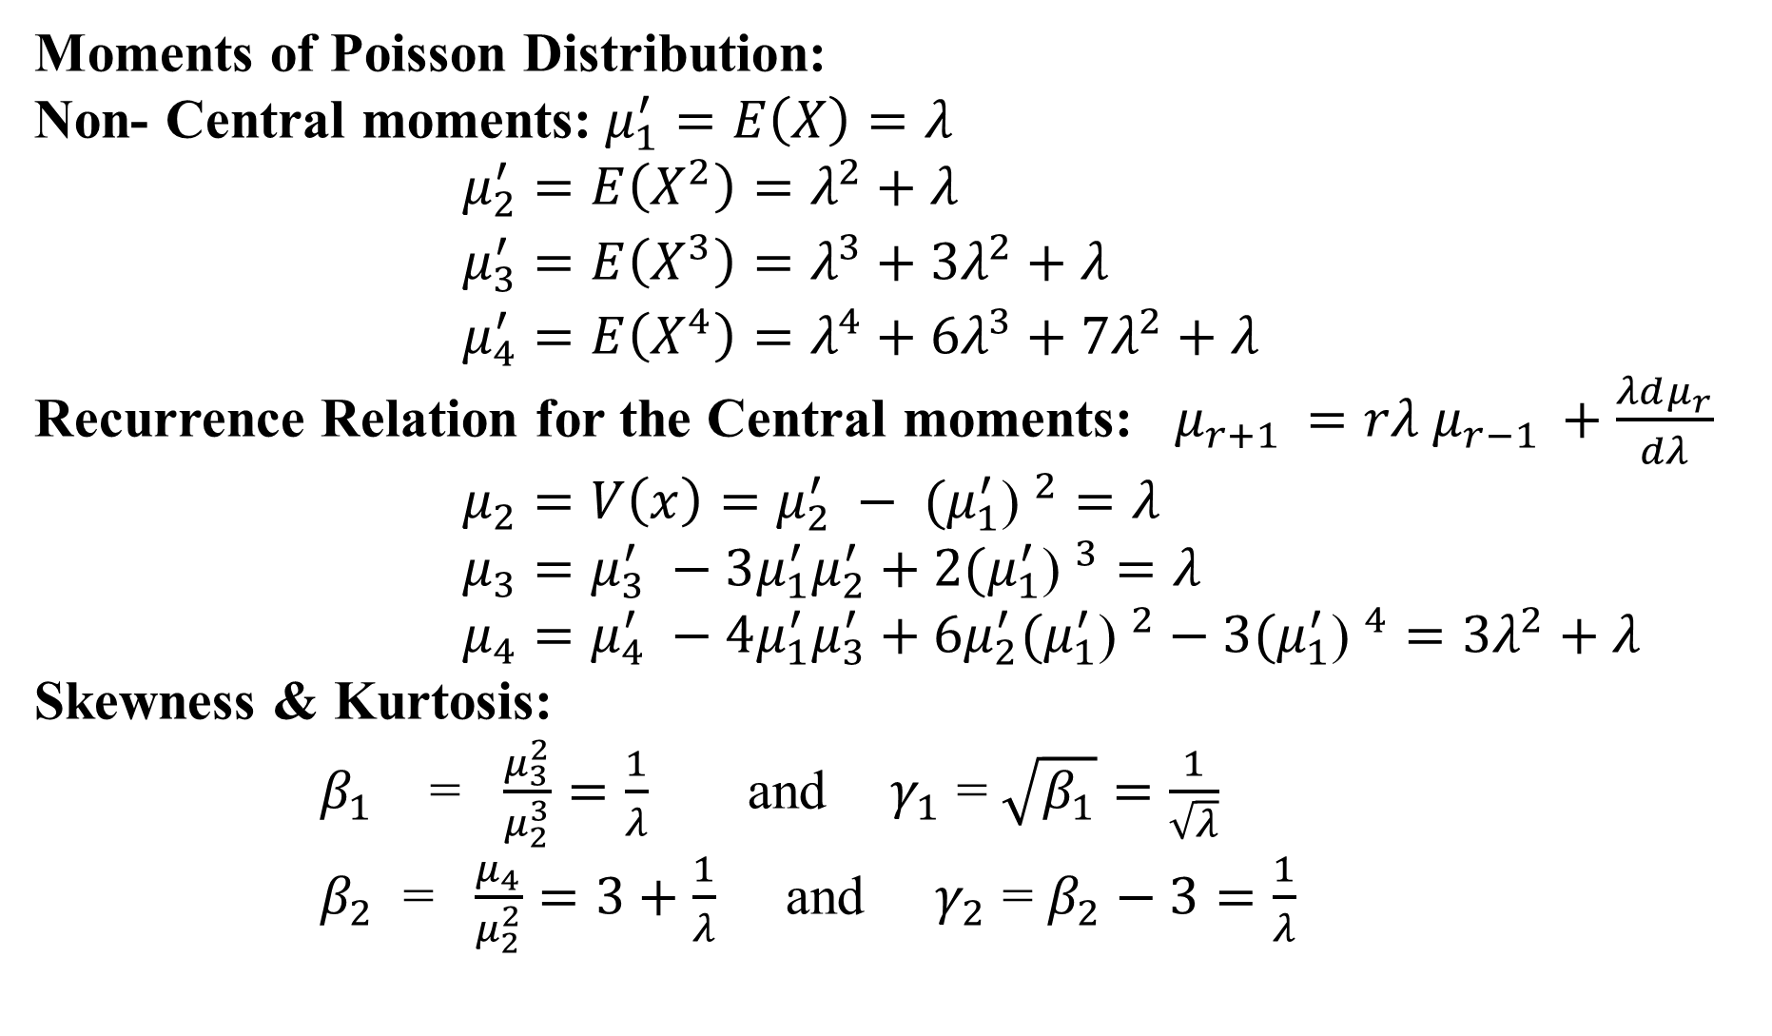
Moments of Poisson Distribution:
Non- Central moments: $μ_{1}^{′}=E\left(X\right)=λ$
$μ_{2}^{′}=E\left(X^{2}\right)=λ^{2}+λ$
$μ_{3}^{′}=E\left(X^{3}\right)=λ^{3}+3λ^{2}+λ$
$μ_{4}^{′}=E\left(X^{4}\right)=λ^{4}+6λ^{3}+7λ^{2}+λ$
Recurrence Relation for the Central moments: $μ_{r+1 }=rλ$ $μ_{r−1 }+\frac{λdμ_{r}}{dλ}$
$μ_{2}=V\left(x\right)=μ_{2}^{′} − {{(μ}_{1}^{′}\text{)} }^{2}=λ$
$μ_{3}=μ_{3}^{′} −3μ_{1}^{′}μ_{2}^{′}+{{2(μ}_{1}^{′}\text{)} }^{3}=λ$
$μ_{4}=μ_{4}^{′} −4μ_{1}^{′}μ_{3}^{′}+6μ_{2}^{′}{{(μ}_{1}^{′}\text{)} }^{2}−{{3(μ}_{1}^{′}\text{)} }^{4}=3λ^{2}+λ$
Skewness & Kurtosis:
$β_{1}$ = $\frac{μ_{3}^{2}}{μ_{2}^{3}}=\frac{1}{λ}$ and $γ_{1}$ = $\sqrt{β_{1}}=\frac{1}{\sqrt{λ}}$
$β_{2}$ = $\frac{μ_{4}}{μ_{2}^{2}}=3+\frac{1}{λ}$ and $γ_{2}$ = $β_{2}−3=\frac{1}{λ}$

Slide 20
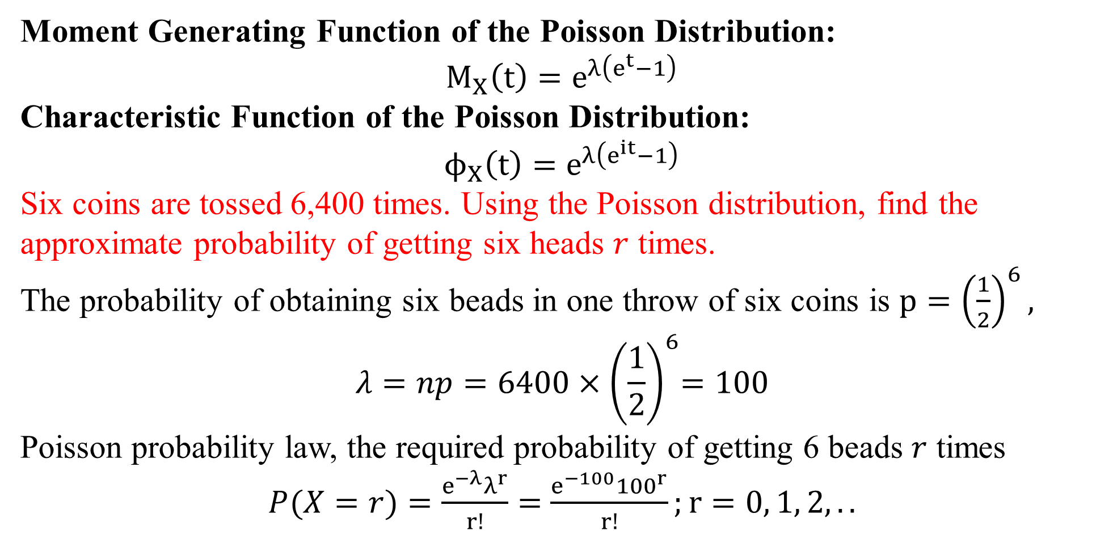
Moment Generating Function of the Poisson Distribution:
$$M_{X}\left(t\right)=e^{λ\left(e^{t}−1\right)}$$
Characteristic Function of the Poisson Distribution:
$$ϕ_{X}\left(t\right)=e^{λ\left(e^{it}−1\right)}$$
Six coins are tossed 6,400 times. Using the Poisson distribution, find the approximate probability of getting six heads $r$ times.
The probability of obtaining six beads in one throw of six coins is $p={\left(\frac{1}{2}\right)}^{6},$
$$λ=np=6400{×\left(\frac{1}{2}\right)}^{6}=100$$
Poisson probability law, the required probability of getting 6 beads $r$ times
$P(X=r)=\frac{e^{−λ}λ^{r}}{r!}=$ $\frac{e^{−100}{100}^{r}}{r!};r=0, 1, 2,..$

Slide 21
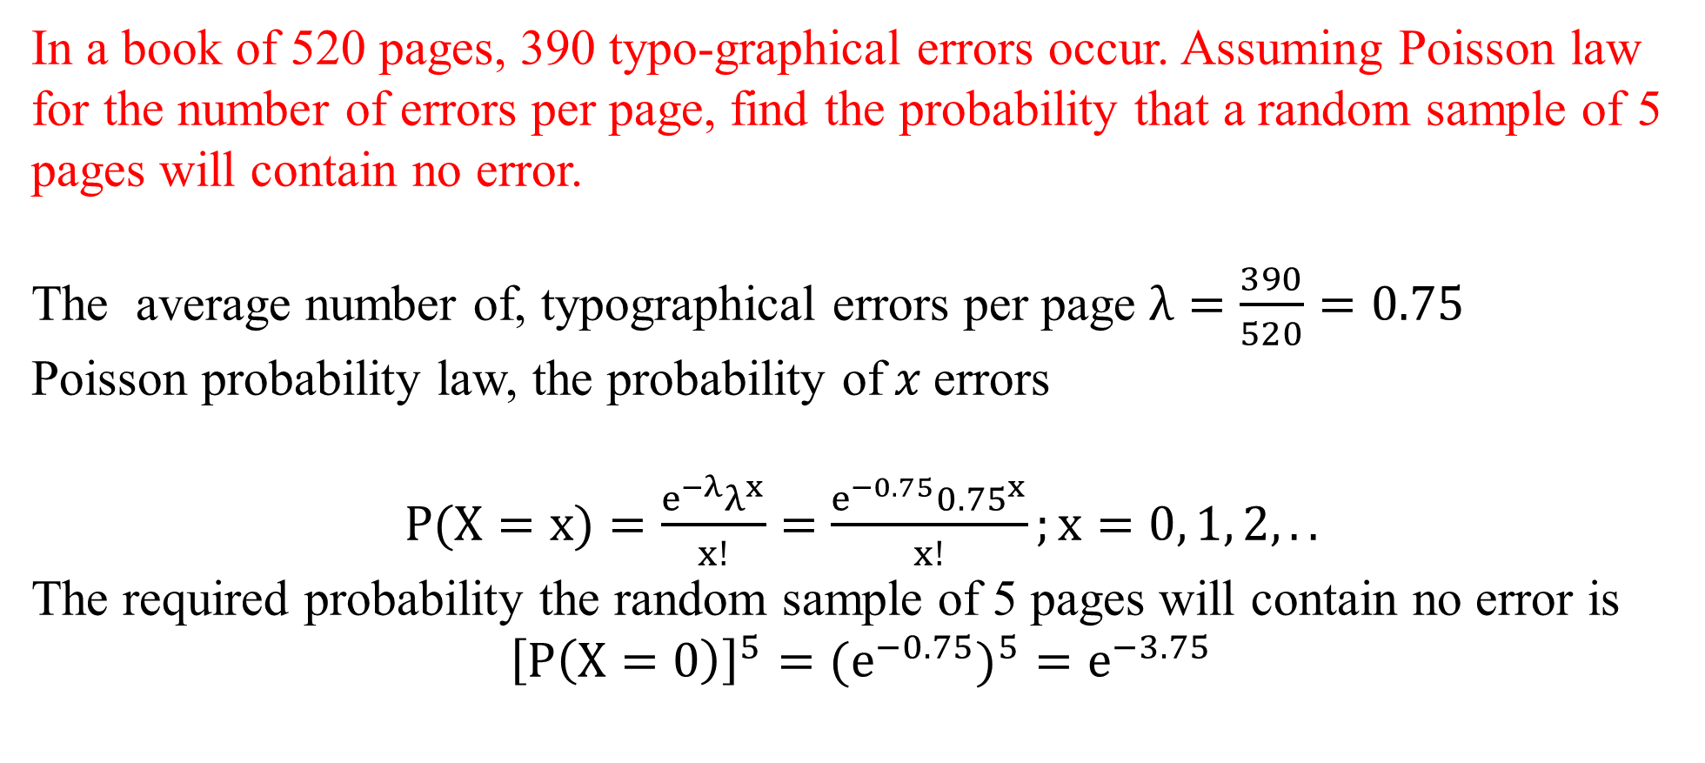
In a book of 520 pages, 390 typo-graphical errors occur. Assuming Poisson law for the number of errors per page, find the probability that a random sample of 5 pages will contain no error.
The average number of, typographical errors per page $λ=\frac{390}{520}=0.75$
Poisson probability law, the probability of$x$errors
$P(X=x)=\frac{e^{−λ}λ^{x}}{x!}=$ $\frac{e^{−0.75}{0.75}^{x}}{x!};x=0, 1, 2,..$
The required probability the random sample of 5 pages will contain no error is
$${\left[P\left(X=0\right)\right]}^{5}={{(e}^{−0.75})}^{5}=e^{−3.75}$$

Slide 22
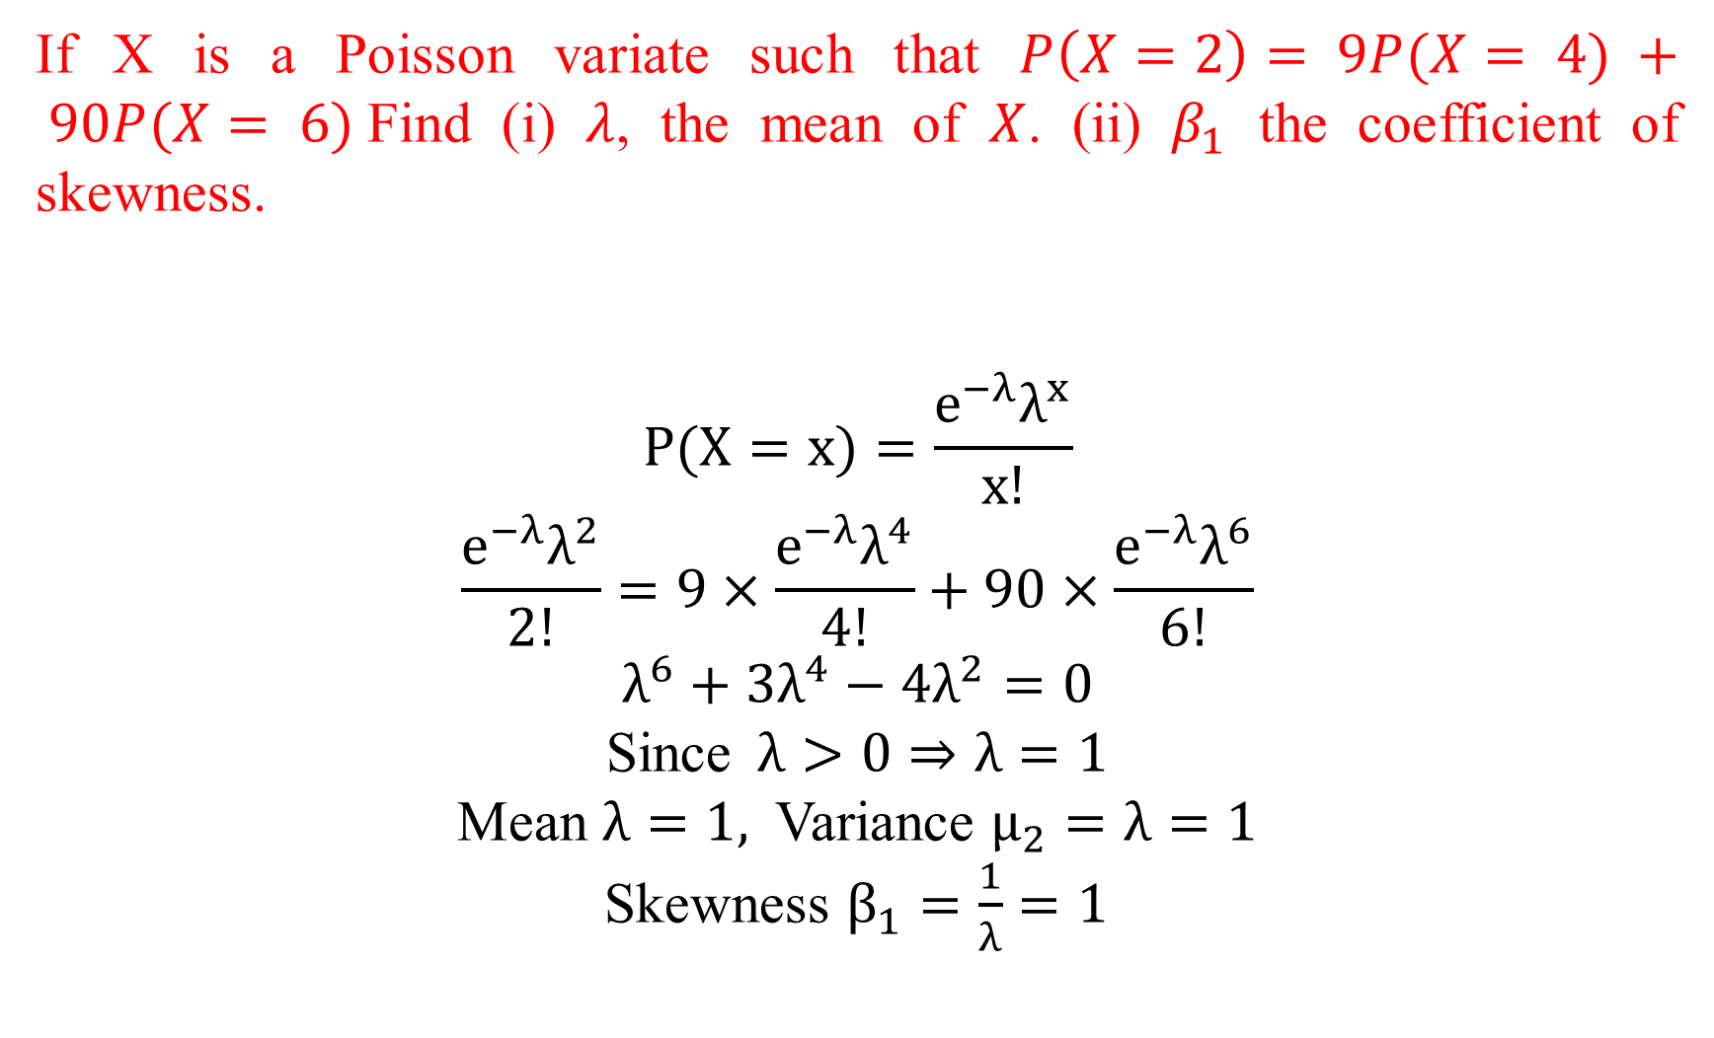
If X is a Poisson variate such that $P\left(X=2\right)= 9P(X= 4) + 90P(X= 6)$Find (i) $λ$, the mean of $X$. (ii) $β_{1}$ the coefficient of skewness.
$$P(X=x)=\frac{e^{−λ}λ^{x}}{x!}$$
$$\frac{e^{−λ}λ^{2}}{2!}=9×\frac{e^{−λ}λ^{4}}{4!}+90×\frac{e^{−λ}λ^{6}}{6!}$$
$$λ^{6}+3λ^{4}−4λ^{2}=0$$
Since$λ>0⇒λ=1$
Mean $λ=1,$ Variance $μ_{2}=λ=1$
Skewness $β_{1}=\frac{1}{λ}=1$

Slide 23
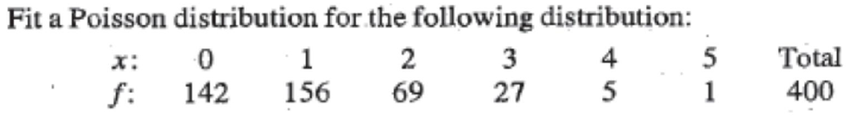
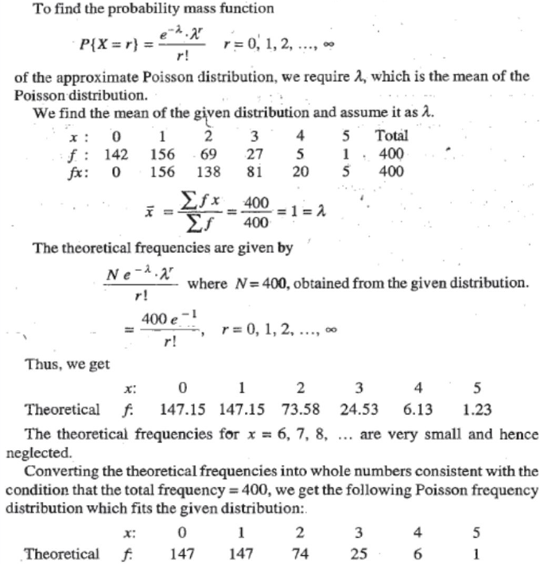

Slide 24
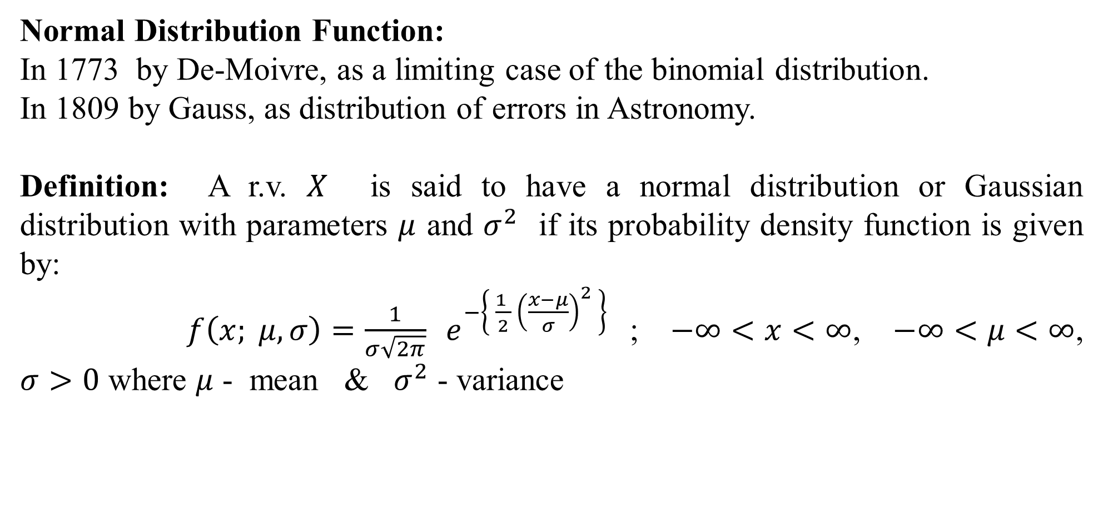
Normal Distribution Function:
In 1773 by De-Moivre, as a limiting case of the binomial distribution.
In 1809 by Gauss, as distribution of errors in Astronomy.
Definition: A r.v. $X$ is said to have a normal distribution or Gaussian distribution with parameters $μ$ and $σ^{2}$ if its probability density function is given by:
$f\left(x; μ, σ\right)=\frac{1}{σ\sqrt{2π}} e^{−\left\{ \frac{1 }{2} {\left(\frac{x−μ}{σ}\right)}^{2} \right\}}$ ; $−∞<x<∞$, $−∞<μ<∞$, $σ>0$ where $μ$ - mean & $σ^{2}$ - variance

Slide 25
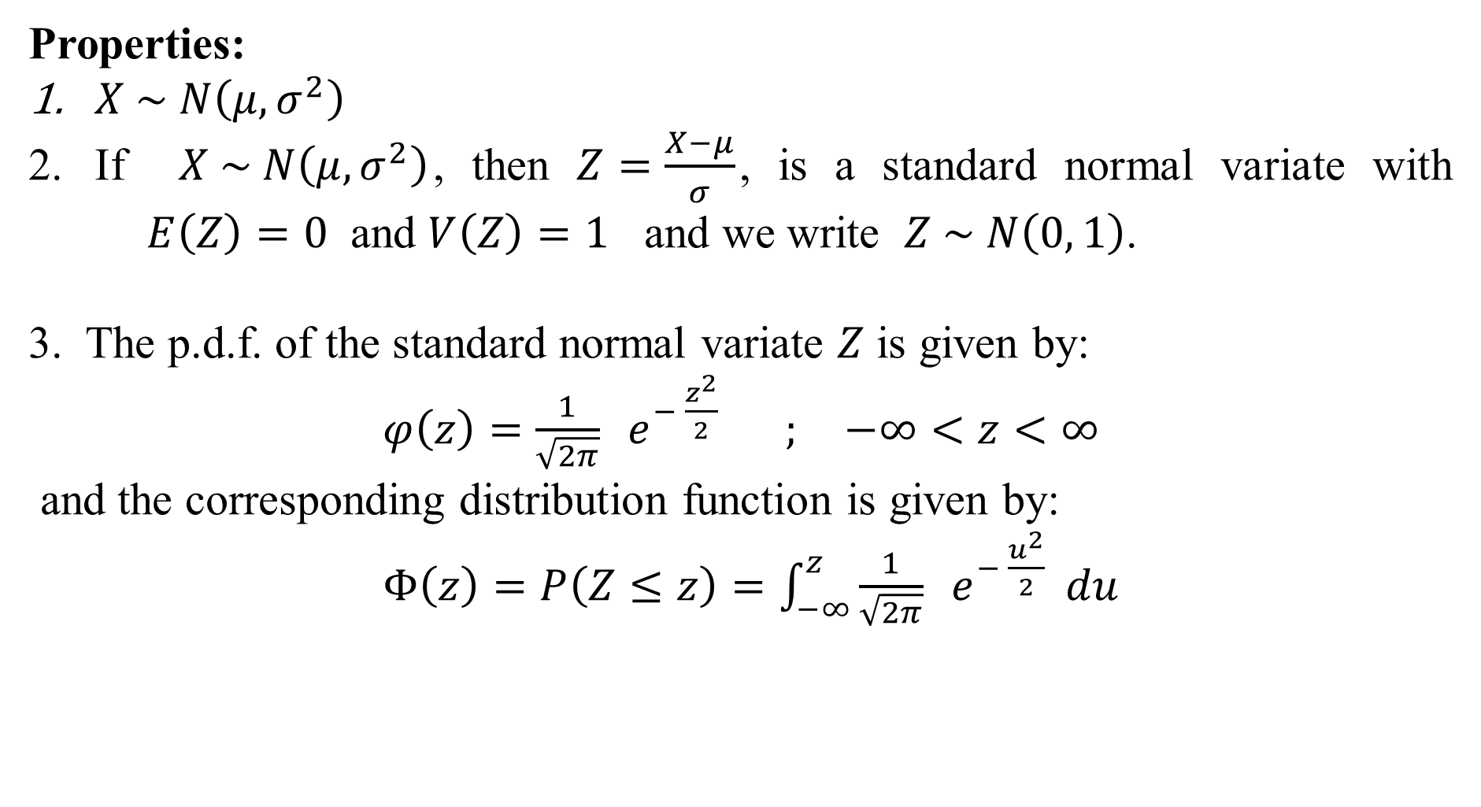
Properties:
$X \sim N\left(μ, σ^{2}\right)$
If $X \sim N\left(μ, σ^{2}\right)$, then $Z=\frac{X−μ}{σ}$, is a standard normal variate with $E\left(Z\right)=0$ and $V\left(Z\right)=1$ and we write $Z \sim N\left(0, 1\right)$.
3. The p.d.f. of the standard normal variate $Z$ is given by:
$φ\left(z\right)=\frac{1}{\sqrt{2π}} e^{− \frac{z^{2}}{2}}$ $; −∞<z<∞$
and the corresponding distribution function is given by:
$Φ\left(z\right)=P\left(Z≤z\right)=\int_{−∞}^{z}{\frac{1}{\sqrt{2π}} e^{− \frac{u^{2}}{2}}} du$

Slide 26
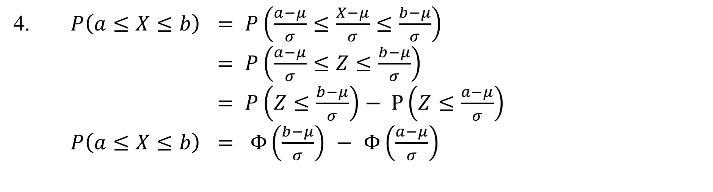
4. $P\left(a≤X≤b\right)$ $=$ $P\left(\frac{a−μ}{σ}≤\frac{X−μ}{σ}≤\frac{b−μ}{σ}\right)$
$=$ $P\left(\frac{a−μ}{σ}≤Z≤\frac{b−μ}{σ}\right)$
$=$ $P\left(Z≤\frac{b−μ}{σ}\right)$ $− P\left(Z≤\frac{a−μ}{σ}\right)$
$P\left(a≤X≤b\right)$ $= Φ\left(\frac{b−μ}{σ}\right)$ $−$ $Φ\left(\frac{a−μ}{σ}\right)$

Slide 27
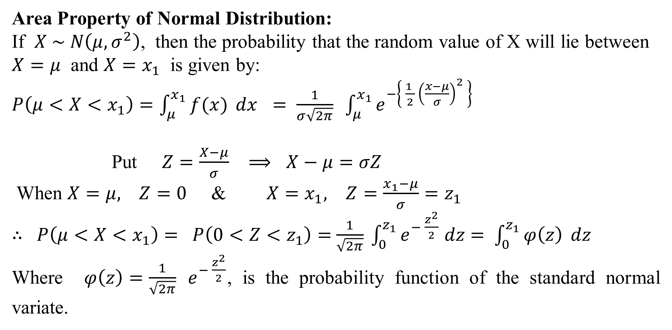
Area Property of Normal Distribution:
If $X \sim N\left(μ, σ^{2}\right)$, then the probability that the random value of X will lie between $X=μ$ and $X=x_{1}$ is given by:
$P\left(μ<X<x_{1}\right)=\int_{μ}^{x_{1}}{f(x)} dx$ $=$ $\frac{1}{σ\sqrt{2π}} \int_{μ}^{x_{1}}{e^{−\left\{ \frac{1 }{2} {\left(\frac{x−μ}{σ}\right)}^{2} \right\}}}$
Put $Z=\frac{X−μ}{σ}$ $⟹$ $X−μ=σZ$
When $X=μ,$ $Z=0$ & $X=x_{1},$ $Z=\frac{x_{1}−μ}{σ}=z_{1}$
$∴$ $P\left(μ<X<x_{1}\right)$ $=$ $P\left(0<Z<z_{1}\right)=$ $\frac{1}{\sqrt{2π}} \int_{0}^{z_{1}}{e^{− \frac{z^{2}}{2}}}$ $dz$ $=$ $\int_{0}^{z_{1}}{φ\left(z\right)} dz$
Where $φ\left(z\right)=\frac{1}{\sqrt{2π}} e^{− \frac{z^{2}}{2}}$, is the probability function of the standard normal variate.

Slide 28
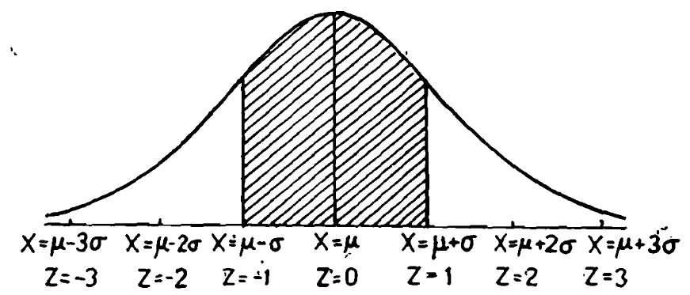
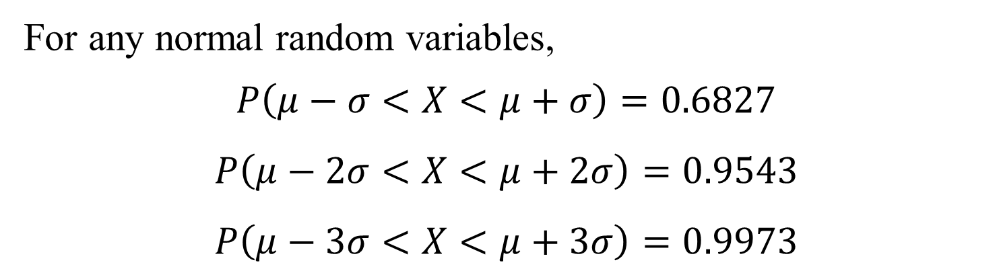
For any normal random variables,
$$P\left(μ−σ<X<μ+σ\right)=0.6827$$
$$P\left(μ−2σ<X<μ+2σ\right)=0.9543$$
$$P\left(μ−3σ<X<μ+3σ\right)=0.9973$$

Slide 29
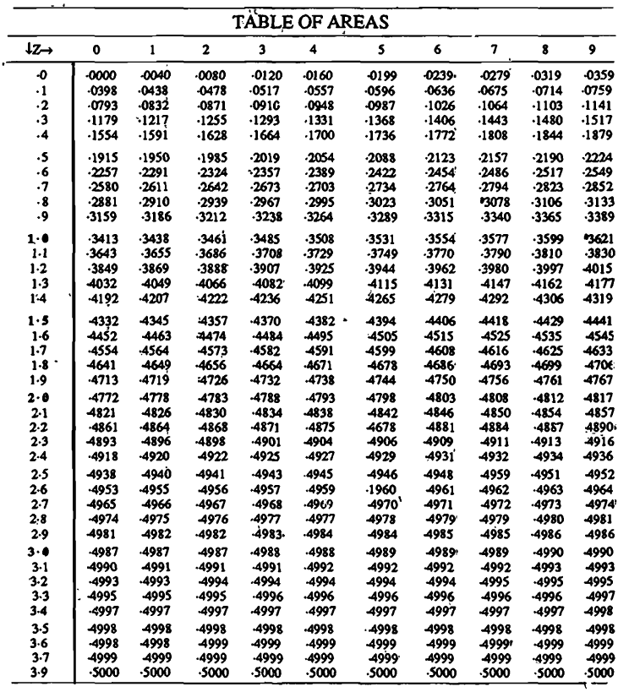

Slide 30
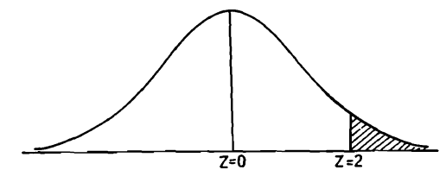
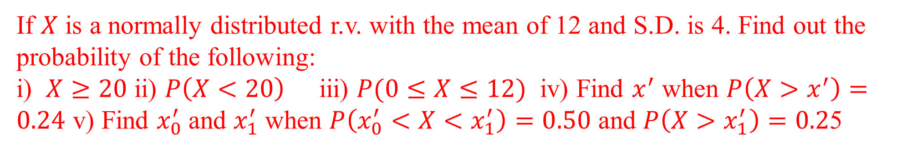
If $X$ is a normally distributed r.v. with the mean of 12 and S.D. is 4. Find out the probability of the following:
i) $X≥20$ ii) $P\left(X<20\right)$ iii) $P(0≤X≤12)$ iv) Find $x^{′}$ when $P\left(X>x^{′}\right)=0.24$ v) Find $x_{0}^{′}$and $x_{1}^{′}$when $P\left(x_{0}^{′}<X{<x}_{1}^{′}\right)=0.50$ and $P\left(X>x_{1}^{′}\right)=0.2$5

Slide 31
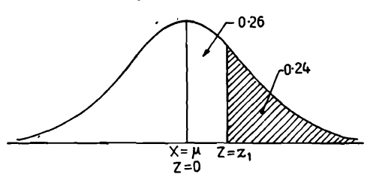

Slide 32
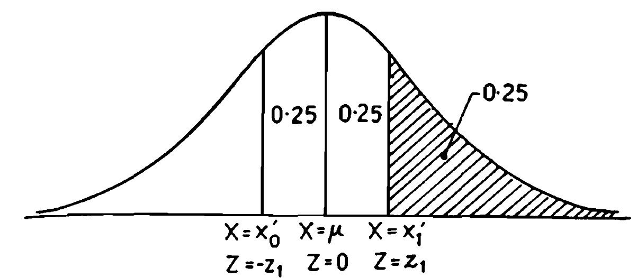

Slide 33
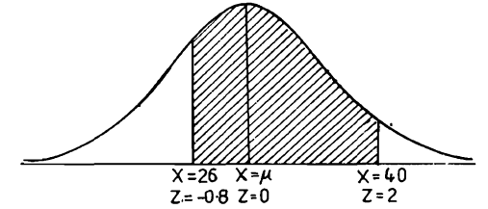
$X$ is a normal variate with mean 30 and S.D. 5. Find the probabilities that
i) $26≤X≤40$, ii) $X≥45$, iii) $\left|X−30\right|>5$

Slide 34
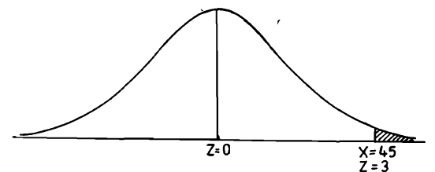

Slide 35
The marks obtained by the students in Mathematics, Physics and Chemistry in an examination are normally distributed with the means 52, 50 and 48 and with S.D. 10 ,8, and 6 respectively. Find the probability that a student selected at random has secured a total of i) 180 or above ii)135 or less

Slide 36
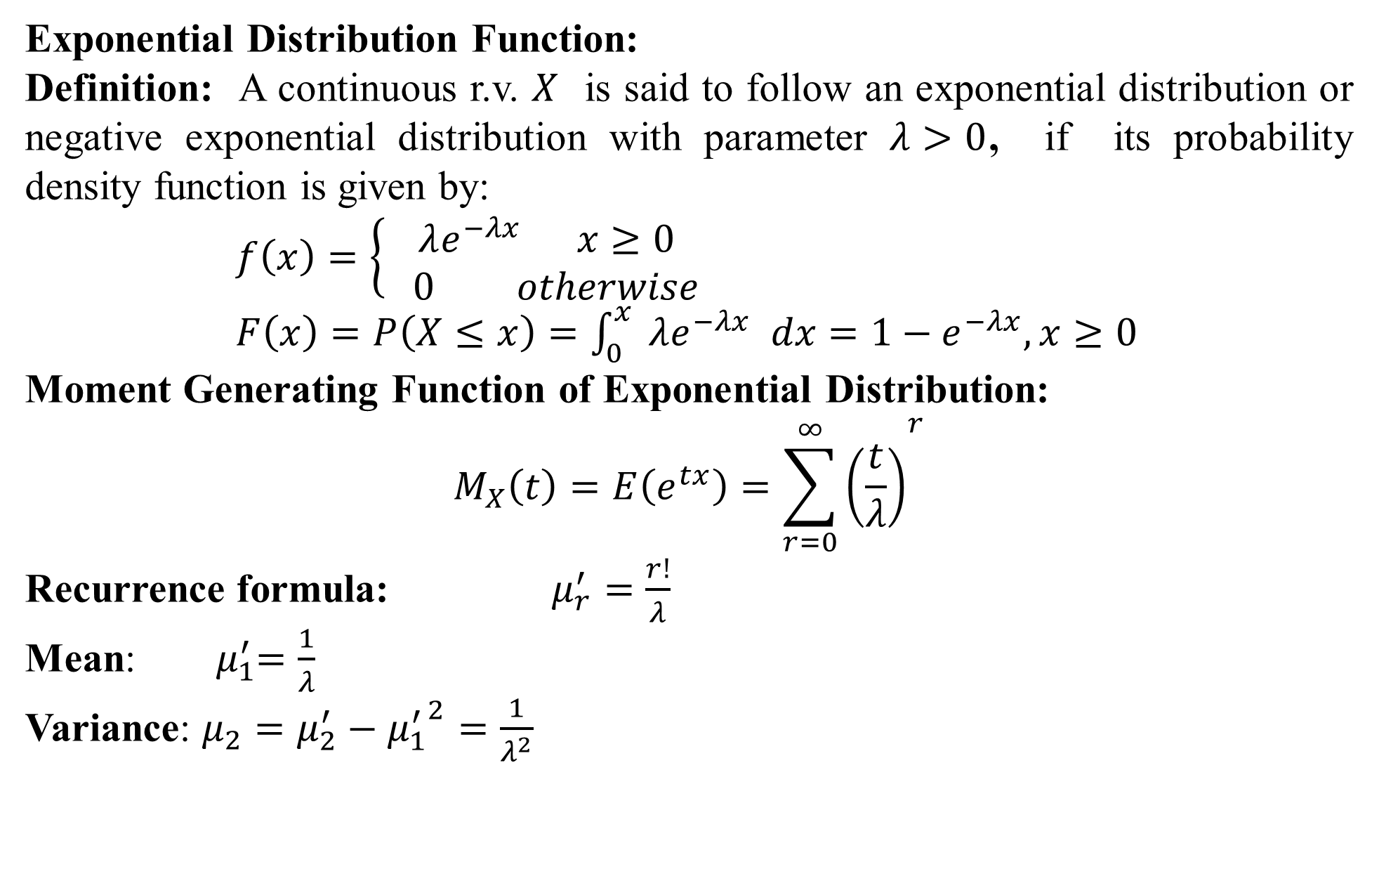
Exponential Distribution Function:
Definition: A continuous r.v. $X$ is said to follow an exponential distribution or negative exponential distribution with parameter $λ>0$, if its probability density function is given by:
$f\left(x\right)=\left\{ \begin{aligned}λe^{−λx} x≥0 \\ 0 otherwise\end{aligned} \right.$
$F\left(x\right)=P\left(X≤x\right)=\int_{0}^{x}{ λe^{−λx} dx}=1−e^{−λx}, x≥0$
Moment Generating Function of Exponential Distribution:
$$M_{X}\left(t\right)=E\left(e^{tx}\right)={\sum_{r=0}^{∞}{\left(\frac{t}{λ}\right)}}^{r}$$
Recurrence formula: $μ_{r}^{′}=\frac{r!}{λ}$
Mean:${ μ}_{1}^{′}=\frac{1}{λ}$
Variance: $μ_{2}=μ_{2}^{′}−{μ_{1}^{′}}^{2}=\frac{1}{λ^{2}}$

Slide 37

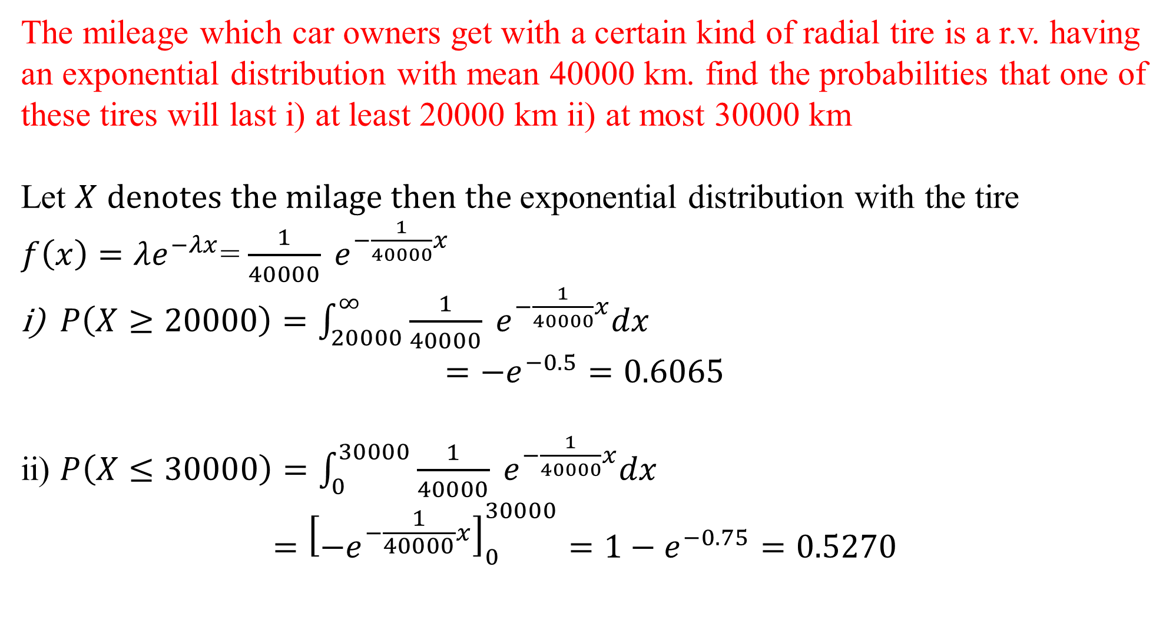
The mileage which car owners get with a certain kind of radial tire is a r.v. having an exponential distribution with mean 40000 km. find the probabilities that one of these tires will last i) at least 20000 km ii) at most 30000 km
Let $X$ $denotes the milage then the$exponential distribution with the tire
$f\left(x\right)=λe^{−λx}$= $\frac{1}{40000} e^{−\frac{1}{40000}x}$
$P\left(X≥20000\right)=\int_{20000}^{∞}{\frac{1}{40000} e^{−\frac{1}{40000}x}dx}$
$$=−e^{−0.5}=0.6065$$
ii) $P\left(X≤30000\right)=\int_{0}^{30000}{\frac{1}{40000} e^{−\frac{1}{40000}x}dx}$
$$={\left[{−e}^{−\frac{1}{40000}x}\right]}_{0}^{30000}=1−e^{−0.75}=0.5270$$
$$∫e^{−ax}dx=−\frac{e^{−ax}}{a}+C$$
$$\lim_{n→∞}{−e^{−x}}=0$$

Slide 38
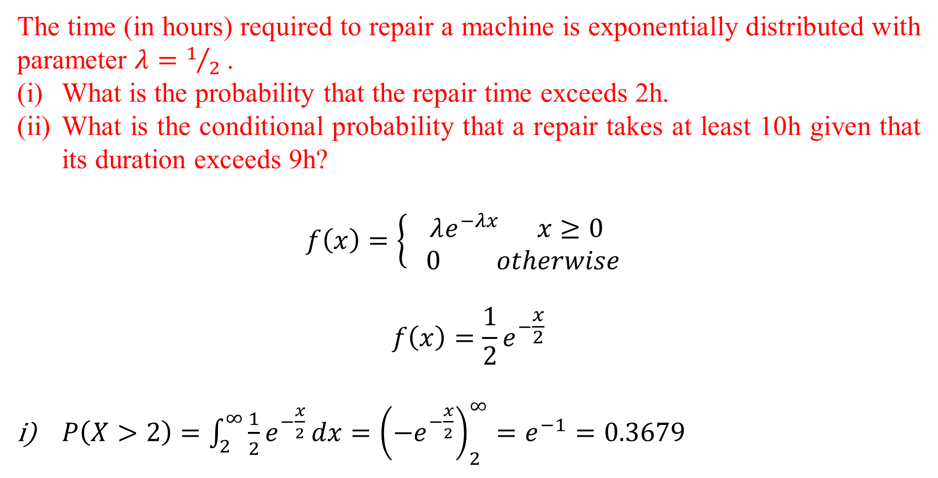
The time (in hours) required to repair a machine is exponentially distributed with parameter $λ=1/2$ .
What is the probability that the repair time exceeds 2h.
What is the conditional probability that a repair takes at least 10h given that its duration exceeds 9h?
$$f\left(x\right)=\left\{ \begin{aligned}λe^{−λx} x≥0 \\ 0 otherwise\end{aligned} \right.$$
$$f\left(x\right)=\frac{1}{2}e^{−\frac{x}{2}}$$
$P\left(X>2\right)=\int_{2}^{∞}{\frac{1}{2}e^{−\frac{x}{2}}}dx={\left(−e^{−\frac{x}{2}}\right)}_{2}^{∞}=e^{−1}=0.3679$

Slide 39
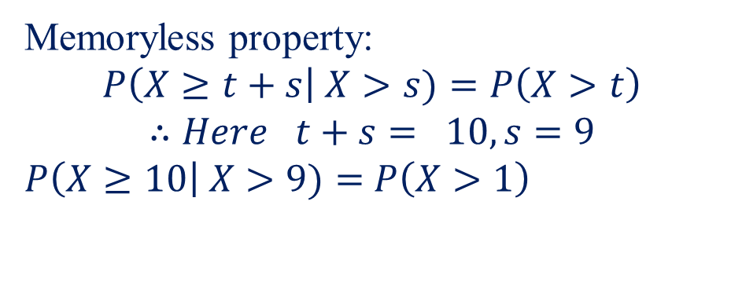
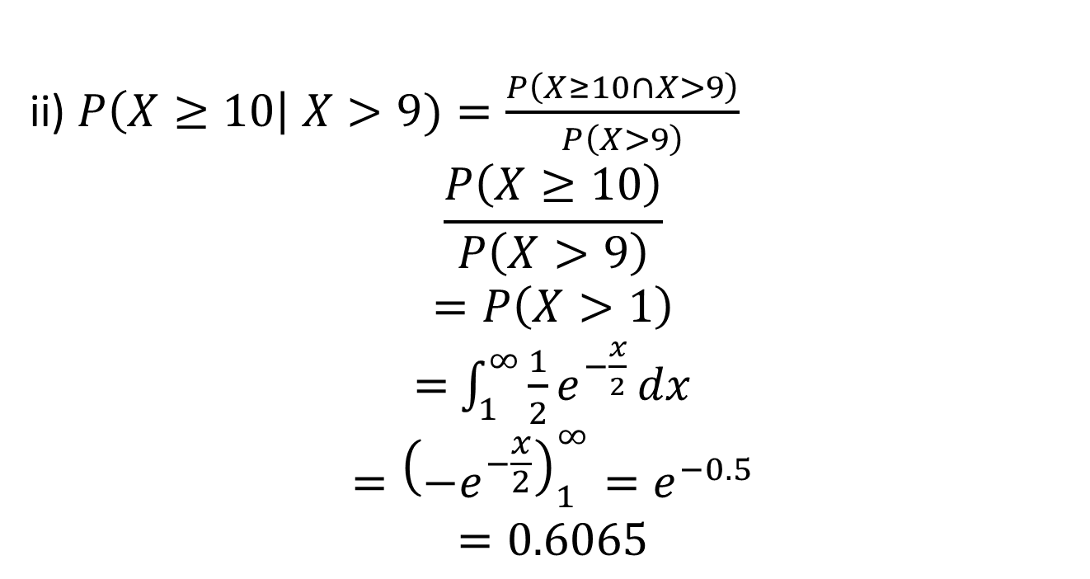
ii) $P\left(X≥10\right| X>9)=\frac{P\left(X≥10∩X>9\right)}{P\left(X>9\right)}$
$$\frac{P\left(X≥10\right)}{P\left(X>9\right)}$$
$$=P\left(X>1\right)$$
$=$ $\int_{1}^{∞}{\frac{1}{2}e^{−\frac{x}{2}}}dx$
$$={\left(−e^{−\frac{x}{2}}\right)}_{1}^{∞}=e^{−0.5}$$
$$=0.6065$$
Memoryless property:
$$P\left(X≥t+s\right| X>s)=P\left(X>t\right)$$
$$∴Here t+s= 10, s=9$$
$P\left(X≥10\right| X>9)=$ $P\left(X>1\right)$

Slide 40
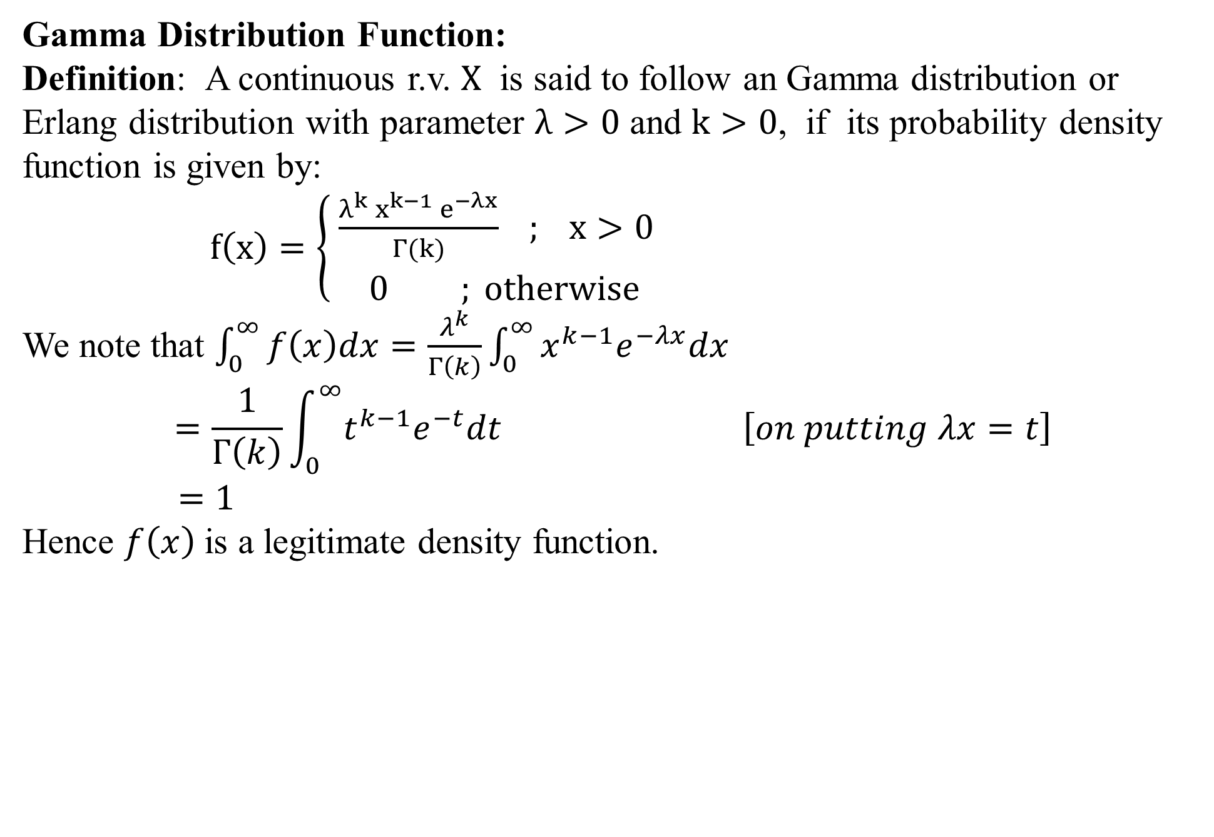
Gamma Distribution Function:
Definition: A continuous r.v. $X$ is said to follow an Gamma distribution or Erlang distribution with parameter $λ>0$ and $k>0$, if its probability density function is given by:
$f\left(x\right)=\left\{ \begin{aligned}\frac{λ^{k}{ x}^{k−1} e^{−λx}}{Γ(k)} ; x>0 \\ 0 ; otherwise\end{aligned} \right.$
We note that $\int_{0}^{∞}{f\left(x\right)dx=\frac{λ^{k}}{Γ\left(k\right)}\int_{0}^{∞}{x^{k−1}e^{−λx}dx}}$
$$=\frac{1}{Γ\left(k\right)}\int_{0}^{∞}{t^{k−1}e^{−t}dt \left[on putting λx=t\right]}$$
$=1$
Hence $f\left(x\right)$is a legitimate density function.

Slide 41
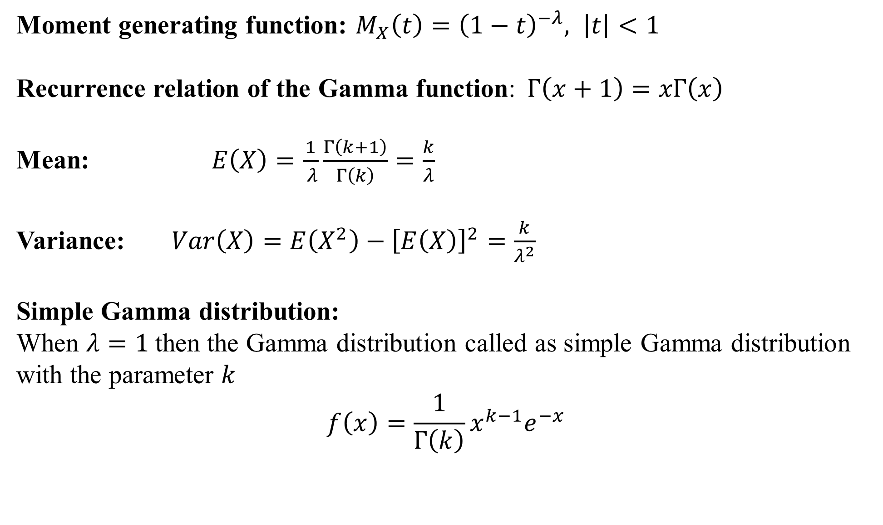
Moment generating function: $M_{X}\left(t\right)={\left(1−t\right)}^{−λ}, \left|t\right|<1$
Recurrence relation of the Gamma function:$Γ\left(x+1\right)=xΓ\left(x\right)$
Mean:$E\left(X\right)=\frac{1}{ λ}\frac{Γ\left(k+1\right)}{Γ\left(k\right)}=\frac{k}{λ}$
Variance:$Var\left(X\right)=E\left(X^{2}\right)−{\left[E\left(X\right)\right]}^{2}=\frac{k}{λ^{2}}$
Simple Gamma distribution:
When $λ=1$then the Gamma distribution called as simple Gamma distribution with the parameter $k$
$$f\left(x\right)=\frac{1}{Γ\left(k\right)}x^{k−1}e^{−x}$$

Slide 42
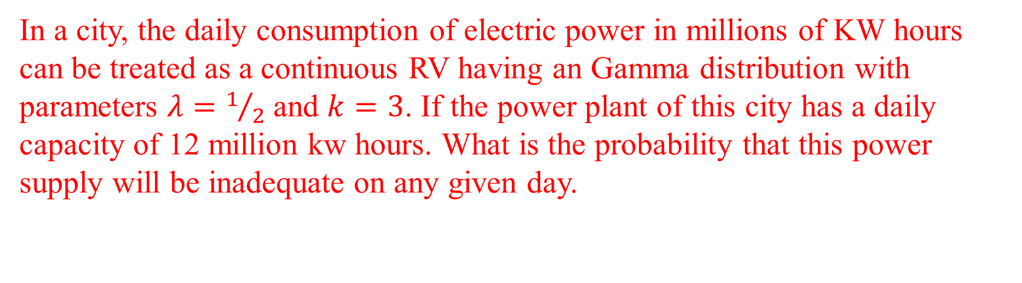
In a city, the daily consumption of electric power in millions of KW hours can be treated as a continuous RV having an Gamma distribution with parameters $λ=1/2$ and $k=3$. If the power plant of this city has a daily capacity of 12 million kw hours. What is the probability that this power supply will be inadequate on any given day.

Slide 43
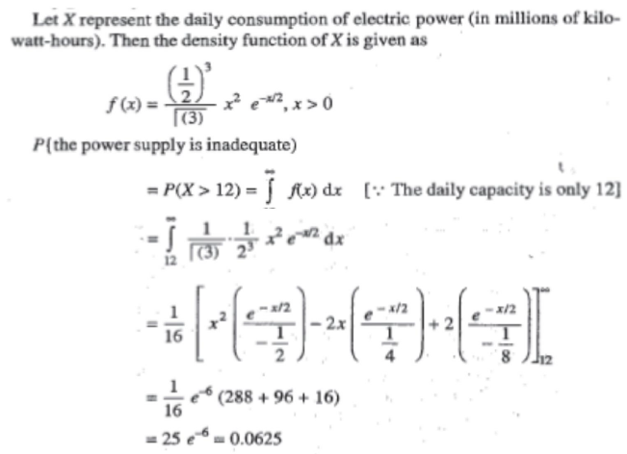

Slide 44
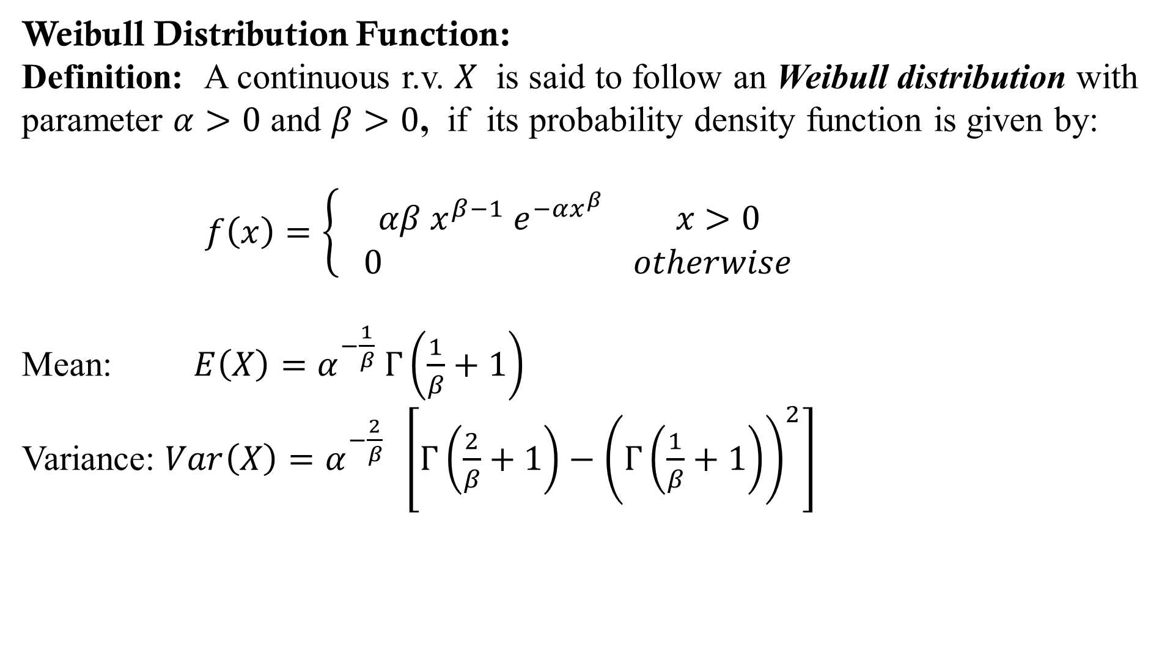
Weibull Distribution Function:
Definition: A continuous r.v. $X$ is said to follow an Weibull distribution with parameter $α>0$ and $β>0$, if its probability density function is given by:
$f\left(x\right)=\left\{ \begin{aligned}αβ{ x}^{β−1} e^{−αx^{β}} x>0 \\ 0 otherwise\end{aligned} \right.$
Mean: $E\left(X\right)=α^{−\frac{1}{β}} Γ\left(\frac{1}{β}+1\right)$
Variance: $Var\left(X\right)=α^{−\frac{2}{β}} \left[Γ\left(\frac{2}{β}+1\right)−{\left(Γ\left(\frac{1}{β}+1\right)\right)}^{2}\right]$

Slide 45





Slide 46
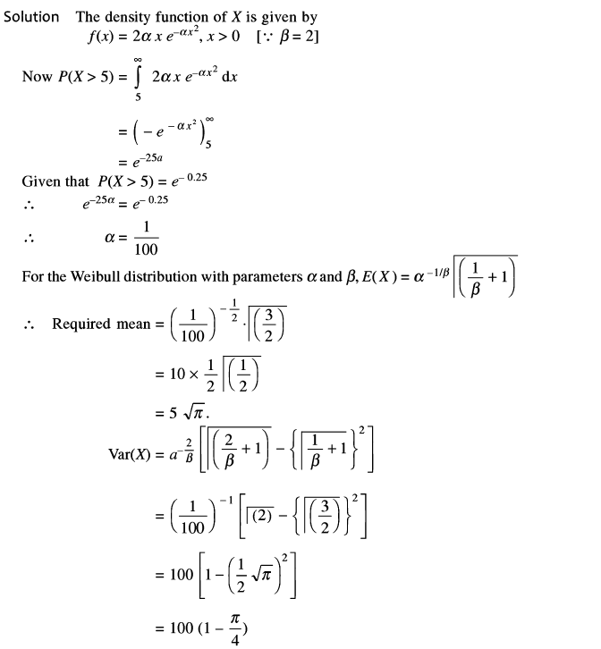

Slide 47
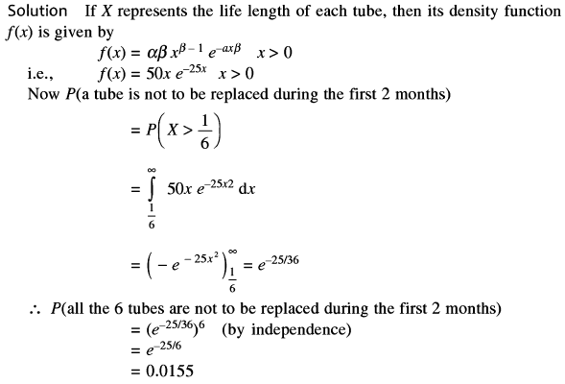
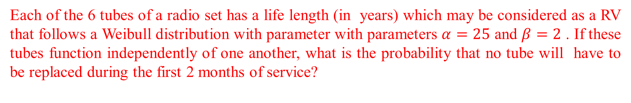
Each of the 6 tubes of a radio set has a life length (in years) which may be considered as a RV that follows a Weibull distribution with parameter with parameters $α=25$ and $β=2$ . If these tubes function independently of one another, what is the probability that no tube will have to be replaced during the first 2 months of service?

